Slide 1
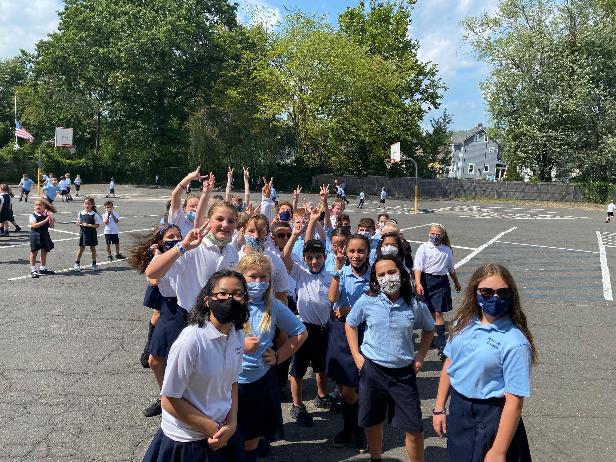
Back to School Night
2021-2022

Slide 2
QUAD SQUAD TEACHERS
Mrs. Perez
aperez@ics41mtn.org
Ms. Terraglia
cterraglia@ics41mtn.org
Mrs. Mish
nmish@ics41mtn.org
Mr. Gottstine
wgottstine@ics41mtn.org
Mrs. Parker
dparker2@ics41mtn.org

Slide 3
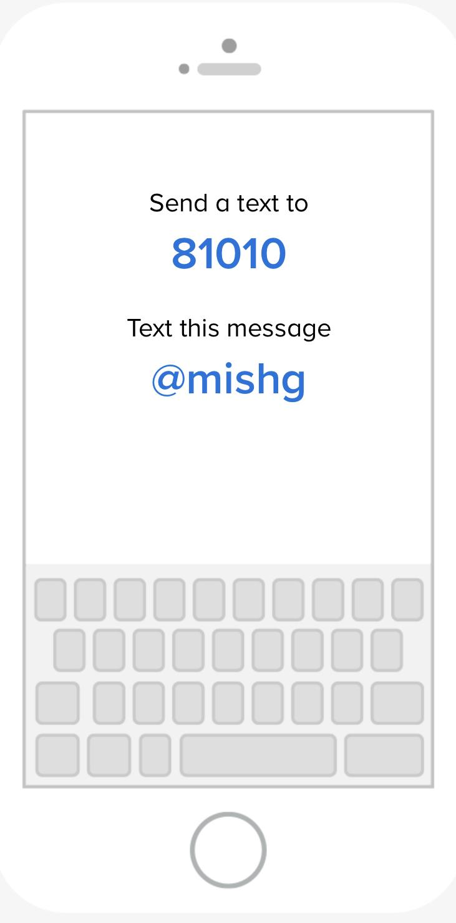
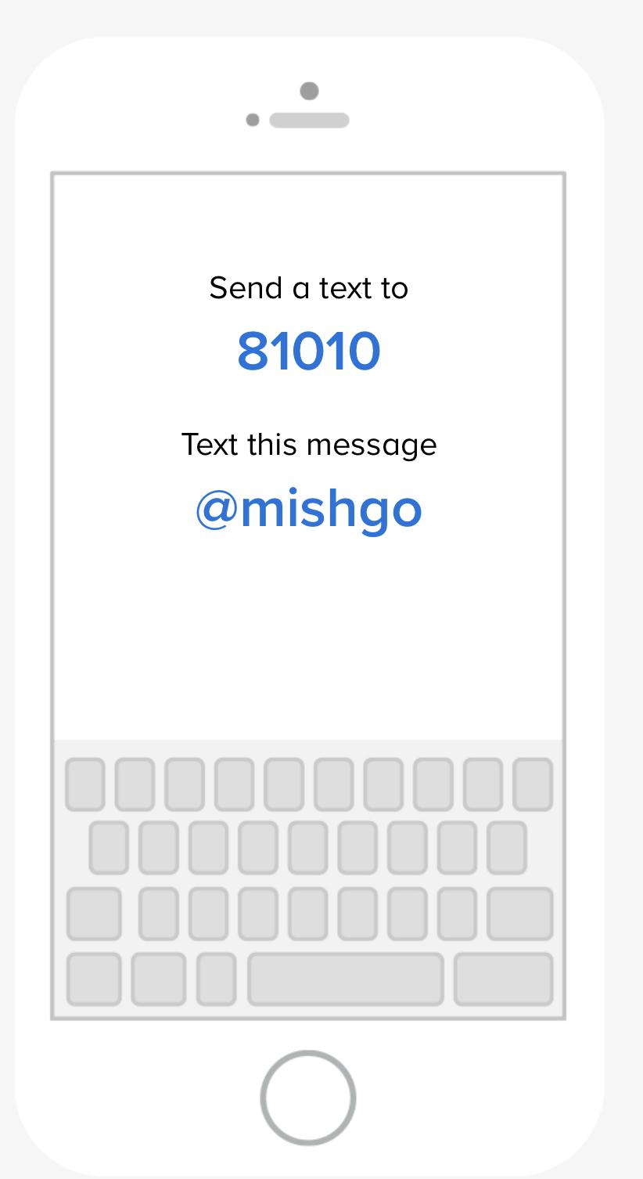
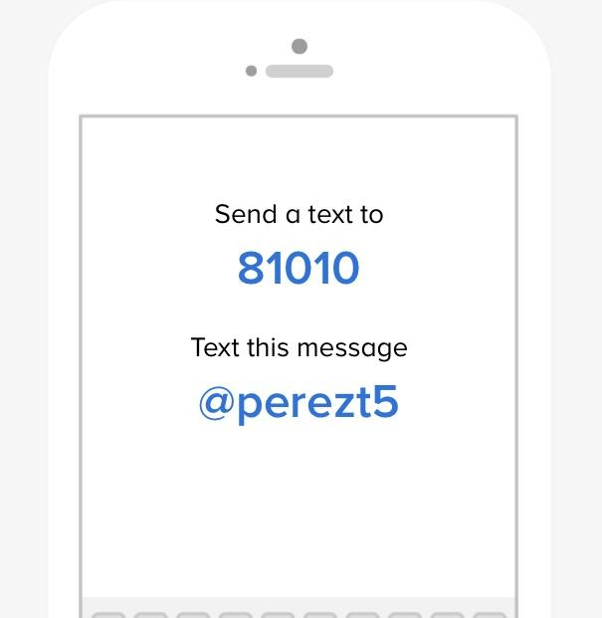
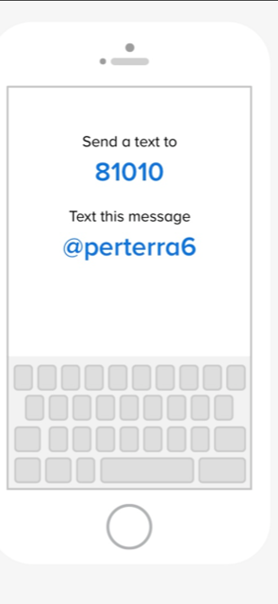
REMIND
Mrs. Mish/Mr. Gottstine
5th 6th
Mrs. Perez/Ms. Terraglia
5th 6th

Slide 4
Language Arts
Reading 60%
Grammar 30%
Vocabulary 10%

Slide 5
MATH
Quizzes/Classwork/Additional Assignments 45%
Tests 35%
Maintenance 10%
IXL 10%

Slide 6
Religion
5th 6th
Classwork/quizzes: 45%
Chapter tests 35%
Religion Maintenance 20%
Classwork/quizzes 45%
Chapter tests 35%
Religion Maintenance 20%

Slide 7
Social Studies 5/6
Quizzes/Classwork 45%
Tests 35%
Additional Assignments: 20%
5th 6th

Slide 8
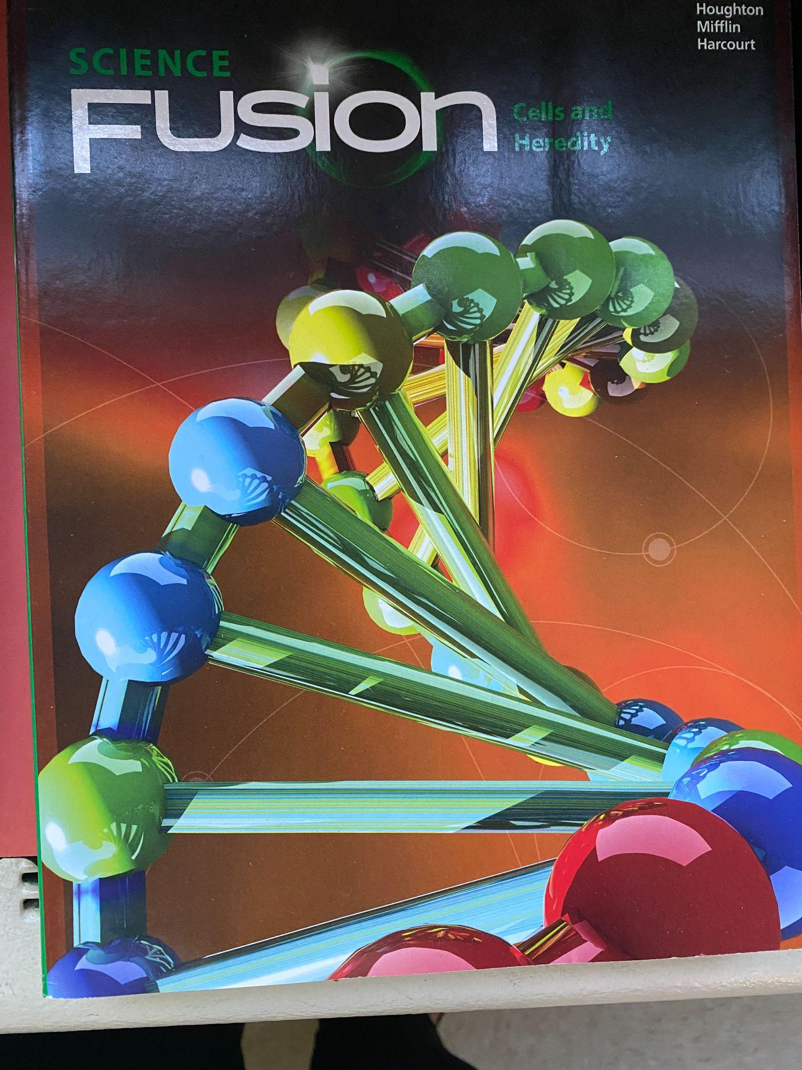
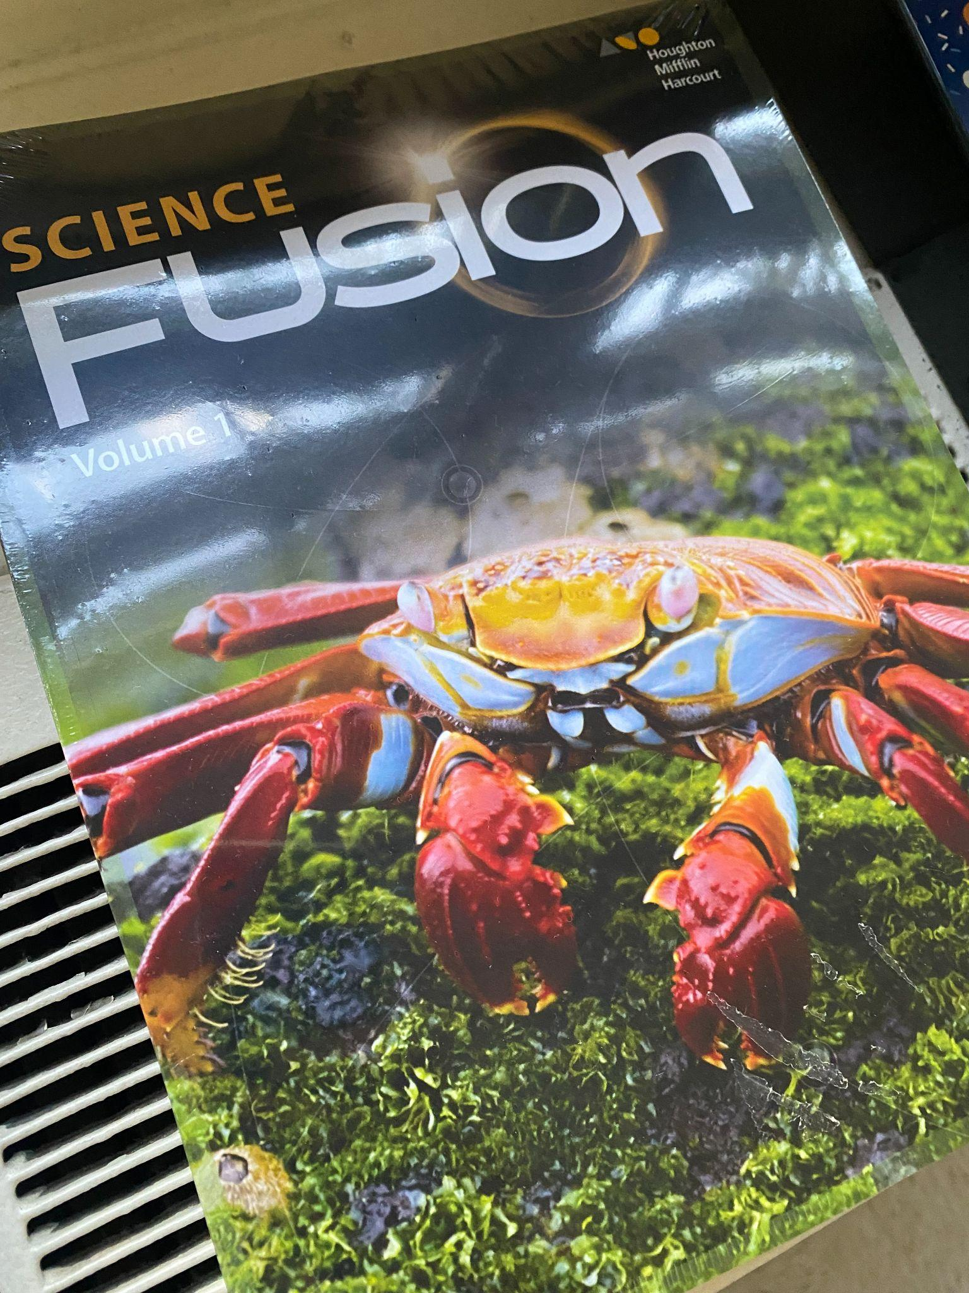
SCIENCE 5/6
6th
5th
Quizzes/Classwork 50%
Tests/Projects 50%

Slide 9
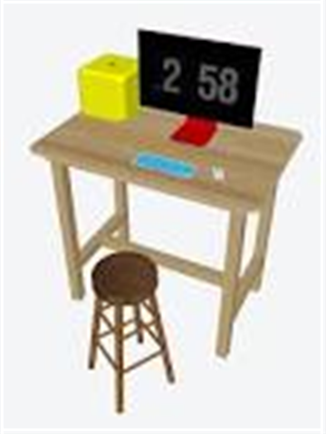
CONFERENCE TIME
When conference time gets closer,
please check your child's Google Drive
for a shared document so you can
sign up for conferences.

Slide 10
Things to Know
Please return all paperwork: Email form, Health History, Stationery $$
Please label all items: book bags, sweaters, etc.
Chromebook cases or sling bags
Follow uniform code found on school website/DEMERITS
See Mrs. Gaffney if you would like to chaperone any event or attend in- school functions
(Diocesan requirements)
Please sign up for REMIND to receive daily communication
No snacks for birthday treats
Daily Snacks permitted: peanut free school and Water only
When emailing teachers, please include the teacher and the office if it is about dismissal

